Slide 1
Hoof Care for Horse Owners

Slide 2
Are your horses hooves holding him back?
What you need to know to keep him sound!!

Slide 3
If you answer YES to any of these you need this course!!
Your horse has abscesses of the hoof on a regular basis.
One or more of the hooves has had White Line disease for several months.
Are your horses heels too low?
The hooves don’t look as good as they used to.
Your farrier won’t do what you want.
Is your horse sore after trimming?
Is the cleft of the frog deep and fleshy?
Are there cracks in the wall of one or more hooves?
Does your horse have mismatched hooves?
Is your horse sore after shoeing?
Has your horse ever lost the whole frog?
Does your farrier complain that the hooves are too soft?
Do you know when your horse is due to have it’s hooves trimmed?
Does your horse avoid hard ground?
Would you like to pay less for shoeing?

Slide 4
Chapter 1
What is good hoof care?
Why is it necessary?
Who should take care of the hooves?

Slide 5
Since people first starting using horses, hoof care has been the responsibility of the horseman. The first book written on the subject about 2500 years ago. Between then and the present many ideas and methods have come and gone on what is best for the maintenance of a healthy hoof.
Today, as with many other fields of study the Internet provides more information but not necessarily clarity to the issue at hand. Thankfully the horses hoof has not changed much over the past centuries and we can still use observations made earlier combined with modern methods to keep the horse as healthy and sound as possible.

Slide 6
The horse evolved to live in a dry grassland environment and his hooves do best when they are kept in that condition. The reality is many horses live in less than ideal conditions. Lack of space, poor drainage, lack of exercise, less than ideal footing, inadequate hoof maintenance, and breeding practices, all lead to health problems of the hoof and horse.
Attention to all of the above will lead to a happier, healthier horse. No matter what the breed of horse or discipline of the horse person there are a variety of hoof problems common to all. If you are having a problem with the hooves of your horse one of the best resources will be an experienced hoof care professional.

Slide 7
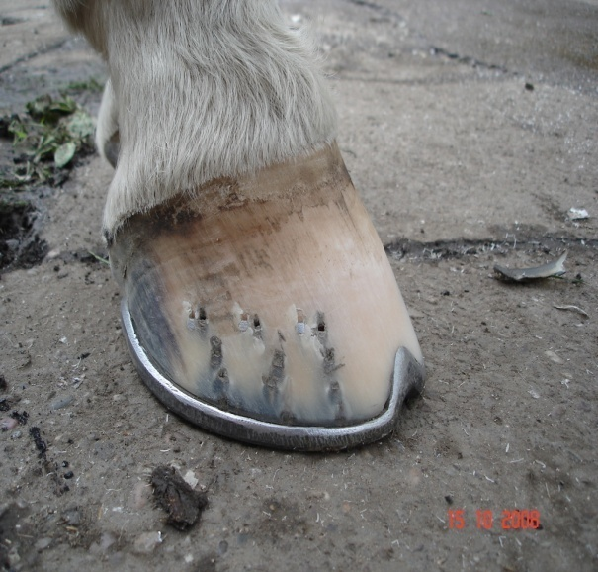
Goals
What is basic hoof care?
Why is it necessary?
When is it needed?
Who should be doing it?

Slide 8
What is it
Good hoof care will keep a horse healthier and owner happier with their performance.
A healthy hoof will be at the ideal length, angle and shape determined by nature for that individual, able to protect the sensitive foot inside the hoof and support the horse under normal conditions.
Breeding and environmental conditions are often the limiting factors that prevent having healthy hooves.
For example, if the horse has a low flat hoof it can never be made into a deep upright one, but keeping the hoof as dry as possible will make the hoof stronger.

Slide 9
Why is it necessary?
A healthy hoof makes for a healthy horse.
A healthy hoof is of particular importance to the horse because unlike us the horse stands on one finger and one toe.
Evolution has developed the modern horse to bear all it’s weight on a very small surface area.
The hoof has to provide, protection to the internal foot, support the weight of the animal, and give traction on various terrain.
The horse should always be able to move, if the hooves restrict the freedom of the horse that animal will have a lower level of overall health.

Slide 10
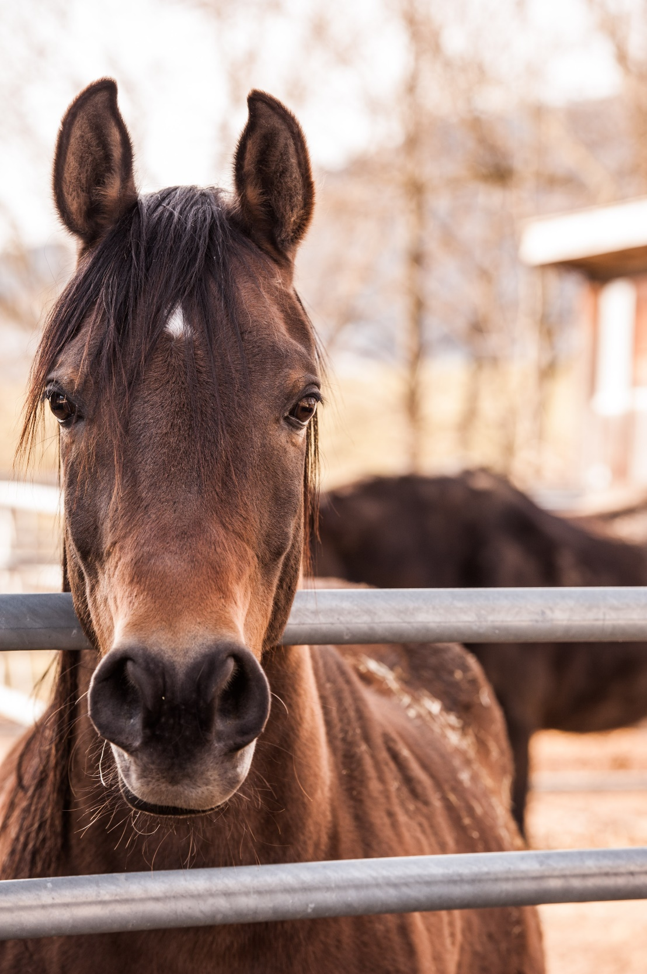
What is a healthy hoof?
A healthy hoof is one that can support the weight of the horse and provide protection to the internal foot under normal circumstances.
Some equine sports could be considered abnormal circumstances.
This can make the goal of equine soundness challenging for owner, farrier, and horse.

Slide 11
The healthy hoof
Single Toe
Provides Protection,
Support and
Traction.
Healthy hoof = healthy horse

Slide 12
What is needed to have a healthy hoof?
Genetics have been shown to have the largest influence on the quality of the hoof of offspring.
The environment, that is the ground conditions, local weather, and size and topography of turn out are also very important.
Farm management, nutrition, health care, paddock and stall maintenance, along with the amount of exercise must be considered.
Of course the skill and experience of the farrier combined with the trimming or shoeing schedule must be tailored to suit the individual horse.

Slide 13
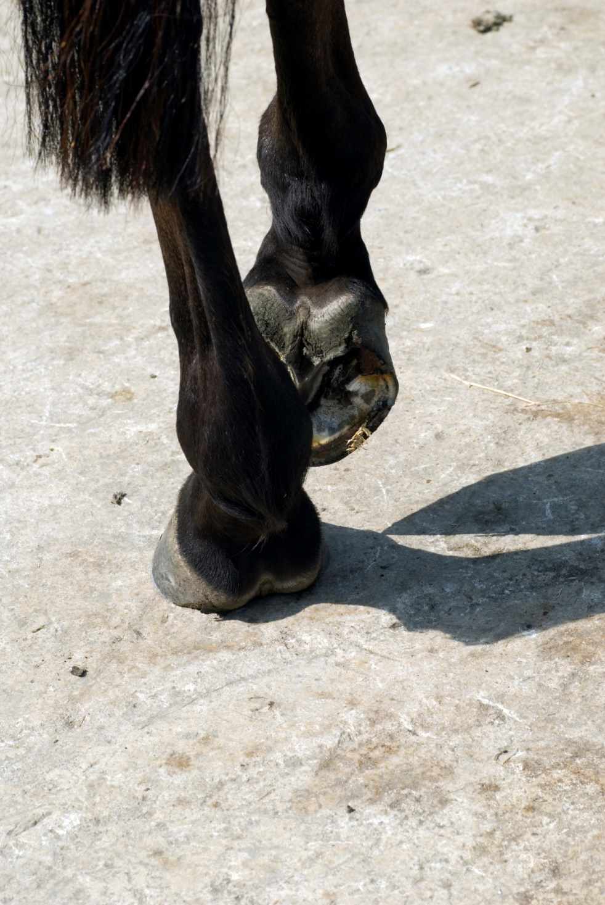
Who should do it?
The daily care should be carried out by the owner.
The regular scheduled trimming done by an experienced farrier.
Any one who does trimming or shoeing is a farrier.
Competent farriers have had a period of formal education and years of practice to develop the required skills needed to do the job.
While there is no requirement to have a proof of education or experience it is the responsibility of the horse owner to find a farrier who can provide the necessary services.

Slide 14
The trimming or shoeing schedule
While six weeks is the standard period between visits by the farrier that is based more on economics than needs of the horse
The last couple of weeks in a six week shoeing cycle will generate the most change to the hoof.
Shortening the schedule by one or two weeks will keep the hoof closer to the ideal hoof length and in a healthier state.

Slide 15
The Period between farrier visits
The rate of change of the hoof is greatest towards the end of the schedule.
Therefore some horses will need a shorter or longer period between farrier visits.
The number of weeks between farrier visits will depend on the conformation of the horse, the environment it lives in, the age of the animal, and the type of work it does.
The rate of growth of a yearling hoof is about twice that of a horse twenty years old.

Slide 16
The Influence of Genetics
The conformation of the parents will have the largest influence on the conformation of the offspring. (1)
Less than ideal conformation of the hoof seems to be one of the most inheritable traits. (2) For example, Club foot, low heels, or flat feet.
If your horse has less than ideal conformation of leg and hoof then careful attention to hoof care will be even more important.

Slide 17
The Environment
A strong healthy hoof is much easier to develop and maintain in a dry climate.
When the hoof, especially the hoof wall, has a higher moisture content it’s in a weaker state.
If other parts of the equation are missing, such as, good conformation, regular care, skilled farriery, inappropriate diet or the horse is being used for demanding work, then hoof problems may result.

Slide 18
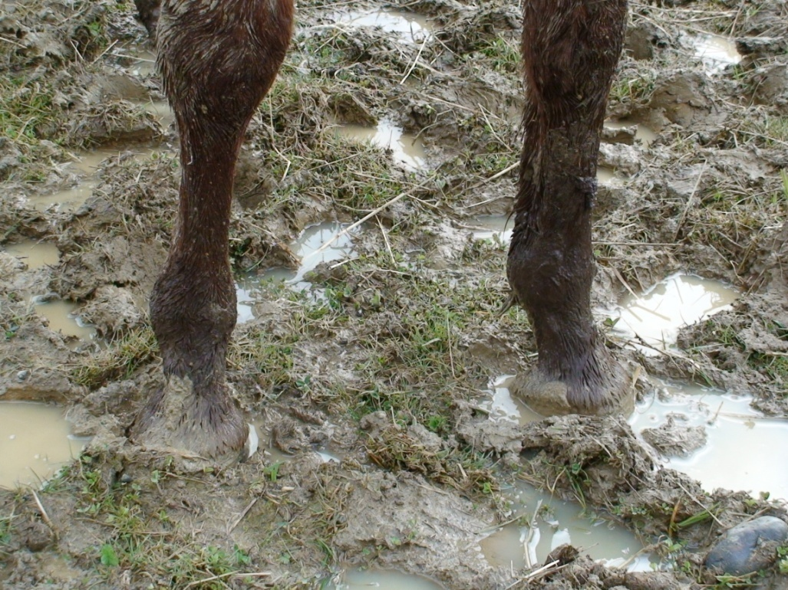
Paddock Surface
A surface with this type of material will keep most hooves in a more healthy state.
This type of condition will only make it challenging to keep the hoof sound and healthy.

Slide 19
Farm Management
While we have the best intentions, often barns and paddocks are designed more for humans than horses.
The best flooring in a stall to maintain a strong hoof is one with a wood floor and spacing between the boards to allow air and moisture to pass through.
Having a stall that allows constant access to a paddock is best. And a paddock surface that will not hold water along with good drainage. Hog fuel is not a good footing for paddocks, it stays wet even in summer, and the wood reacts negatively with the hoof.
Hoof quality is directly related to diet. What you put is what you get out.
The single biggest complaint of farriers in the Fraser Valley is hooves that are too wet.

Slide 20
Wooden Stall Floor
The best wood for a stall floor is Cottonwood. It will not splinter, yet will wear very well. Rough cut 2” boards laid over large timbers and gravel, with spacing between the boards will allow moisture to drain from the bedding.

Slide 21
Exercise
Horses need to be moving for most of the day. Usually at a slow walk, with some short bursts of faster activity periodically. Picture a horse grazing in a herd. If a horse is confined to a stall or small paddock it’s vital for hoof health that it’s exercised every day, this will improve the circulation to the lower leg and hoof.
On the other hand some competition horses are worked so hard that the hoof is over stressed. When the hoof is already disadvantaged by other factors this can lead to problems.

Slide 22
Diet
The most common dietary problem linked to the hooves is overfeeding.
A recent survey in the U.K. found 80% of horses are over weight. And most horse owners can not tell when their horse is too fat.
If your horse is overweight that means the hooves are overloaded even without a rider on board.
If the weight to hoof ratio is greater than 80lbs./sq. inch the horse is considered either overweight for it’s hoof or the hoof is too small. (Turner, 1992)
Having a crest on the neck is a good indicator that this horse is over weight.

Slide 23
Nutrition and healthy hooves
Numerous studies have shown that either a deficiency or an excess of nutrients can affect hoof quality. This can either be due to improper diet or a circulatory problem. Due to genetics some horse will have poor hoof quality even with an adequate diet. The following list may affect hoof growth and substance.
Vitamin A. A deficiency of this vitamin may result in a band of scaly hoof wall below the coronary band.
Biotin. (Vitamin H) Many commercial feeds have biotin added.
Calcium
Methionine. Part of the essential building blocks for important amino acids found in the hoof.
Pyridoxine. (Vitamin B6) Needed to process Methionine.
Selenium.
Sulfur. Necessary for forming strong bonds within the hoof structure.
Zinc. Important for tissue growth and repair.

Slide 24
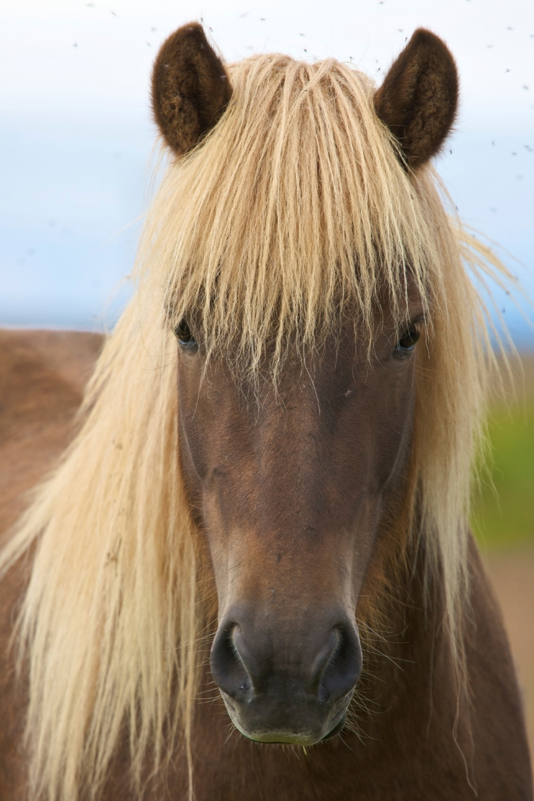
Chapter 2.
What is the hoof?
Where does it grow from?
How many parts are there to the hoof?
What makes a hoof healthy or diseased?

Slide 25
What is the hoof?
The hoof is modified skin. A pliable wrapper covering the end of the leg. The hoof protects the Coffin bone, Navicular bone, tendons, ligaments and other associated structures.
The hoof can be divided into distinct parts and areas.
The health of one part is dependant on the health of the adjoining parts.
The proper functioning of an area is related to the overall health of the hoof.

Slide 26
The ideal hoof
In proportion to the size of the animal, neither too big nor too small.
Making a matched pair.
A hoof wall that is strong enough to carry the weight of the horse without bending.
The front face at the same angle as the pastern and shoulder.
Both front face and heel being a similar angle.
The heel length about 1/3rd. the length of the toe.
The ground surface should be a symmetrical shape.
Length from toe to heel about equal to the widest part.
A sole thick enough to resist flexing under thumb pressure.
A frog that contacts the ground, has a shallow central depression and is about 1 ½ times longer than wide.

Slide 27
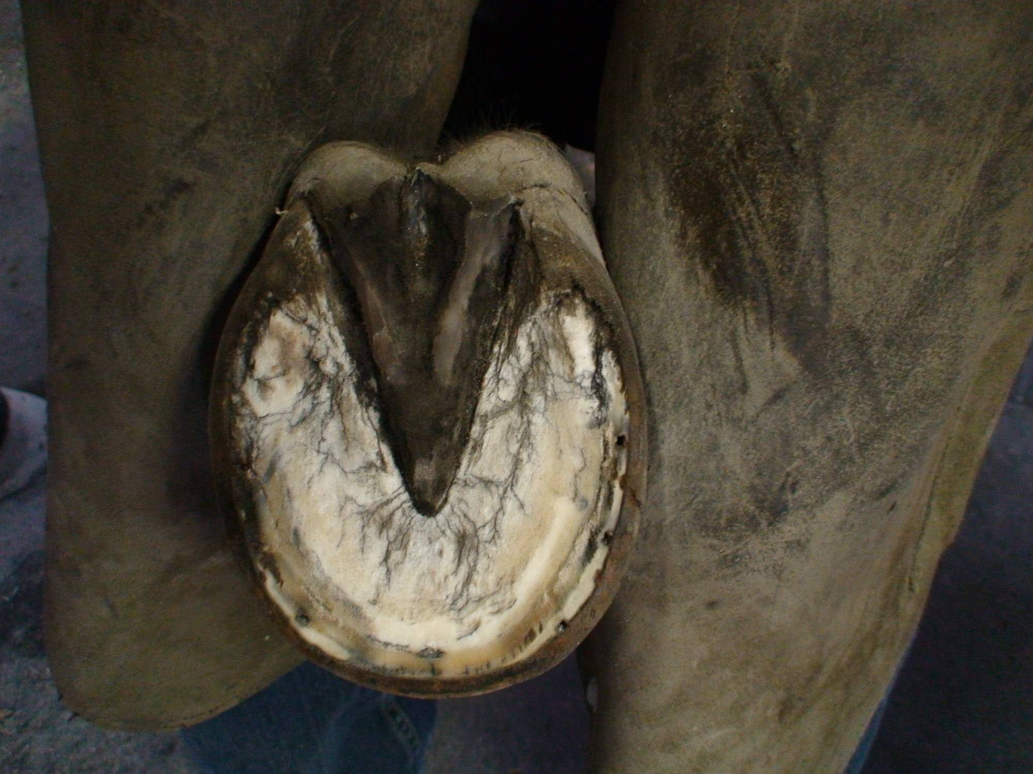
Parts of the hoof
Periople
Frog
Wall
Sole
White line

Slide 28
Areas of the hoof
Heel bulb
Frog cleft
Heel
Seat of corn
Quarter
Bar
Toe

Slide 29
The Periople
The periople forms the upper border of the hoof.
A healthy periople will have a texture similar to the frog or bulbs of the heel.
The periople will swell when saturated by moisture, such as morning dew. This is normal.
Towards the ground border of the wall the periople may be worn off, again this is normal.
Notes:
Add picture of a scaly periople.

Slide 30
An Unhealthy Periople
A periople that has a persistent crusty appearance.
Hair on the coronary band that stands out from the hoof.
Deep fissures through the periople.
All of the above may be indicators of a vitamin or mineral deficiency.

Slide 31
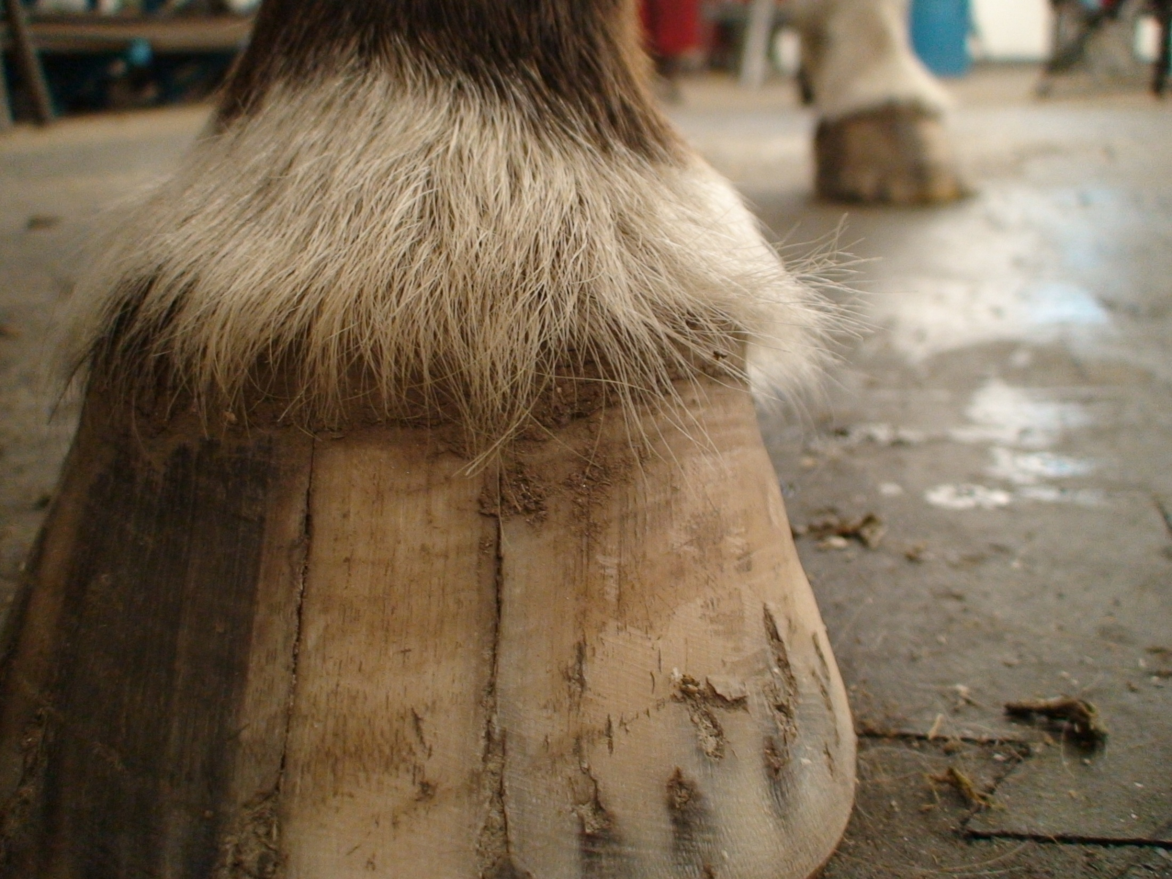
Hair standing out
Crusty appearance
Multiple shallow cracks

Slide 32
The Healthy Wall
The majority of the wall is produced from the coronary band and of constant thickness from hairline to ground. A healthy wall will form a straight line angled towards the ground.
Extending from heel to heel and coronary band to ground. The wall is the primary weight bearing area of the hoof.
A thick hoof wall will be easier to keep healthy than a thin wall.
Wall thickness is directly connected to breeding.
A healthy wall will be free of cracks and form a straight sloped line from coronary band to ground
The sole, produced from the bottom of the coffin bone.
White line
A narrow band produced from the edge of the coffin bone.

Slide 33
The ideal hoof wall
Thick at the toe, thinning slightly at the quarters, with a strong heel formed from the wall and bars.
The slop or angle of the toe equal to that of the pastern bones.
The slope of the toe and heel similar.
Produced from the coronary band at a rate sufficient to replace that worn away by movement of the horse.
Most horses hooves will measure between 3” – 4” from coronary band to ground at the toe.

Slide 34
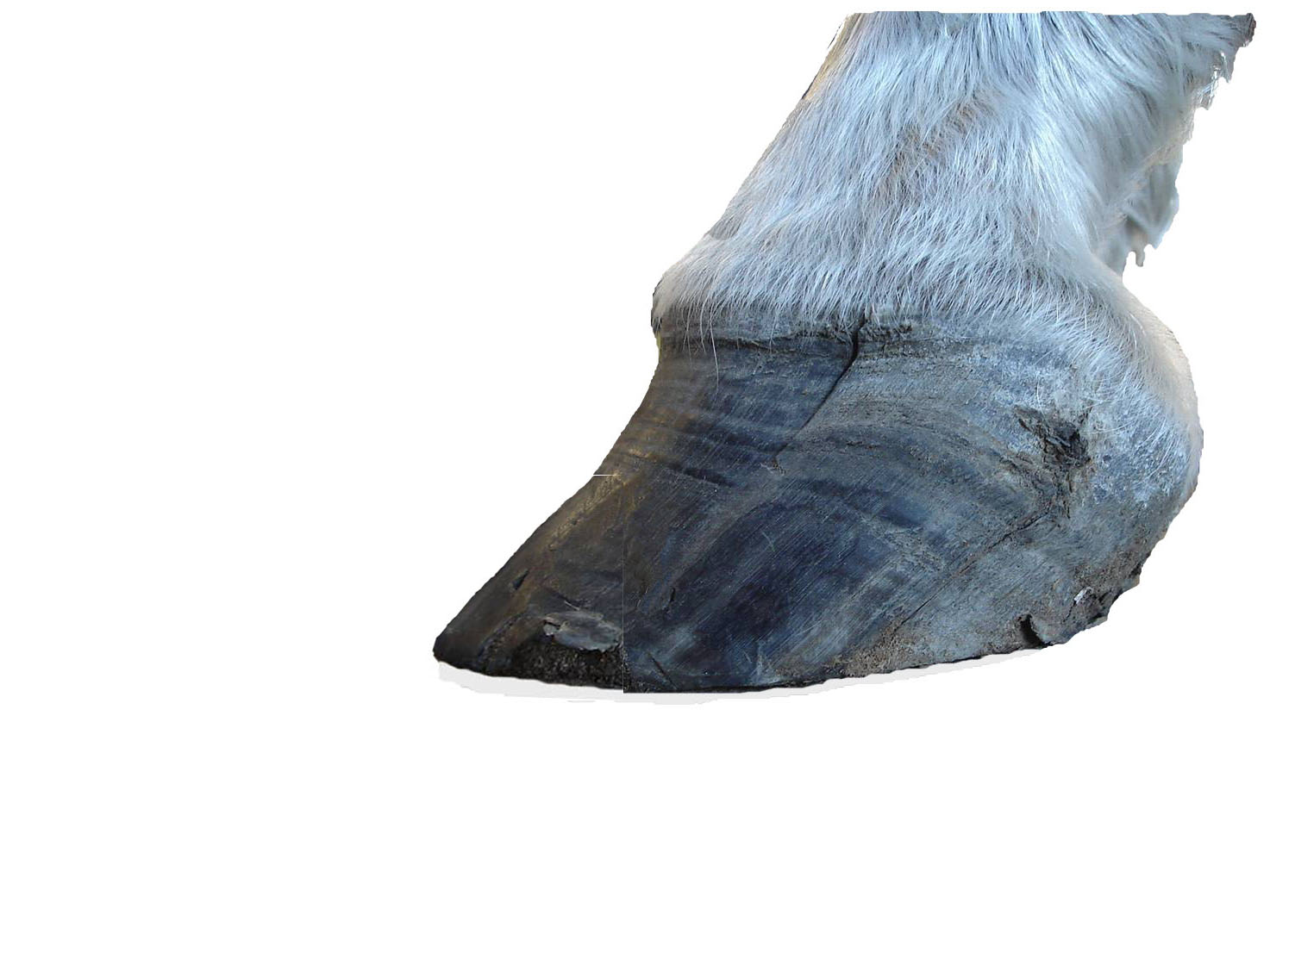
Do You Have A Hoof That Looks Like This
Cracks may be due to, an unbalanced hoof, trauma, or infection.
Flares or dishes, hoof too long,
weak, or overloaded.
Separations, overloading, wall too long, poor shoe fitting.
Displacement, uneven loading of one area of the hoof.
Scar tissue from old injury.

Slide 35
A hoof wall too long
When the hoof wall is allowed to grow too long that may cause tearing of the attachment of bone to hoof. This creates an unstable hoof and allows bacteria and fungus to invade the inner regions of the hoof and sensitive tissue of the foot.
The ideal length for the toe, measured from coronary band to ground will range between 3” – 4” for most horses
3” – 4”
If your horses hooves look like this then the schedule is too long or the farrier needs help

Slide 36
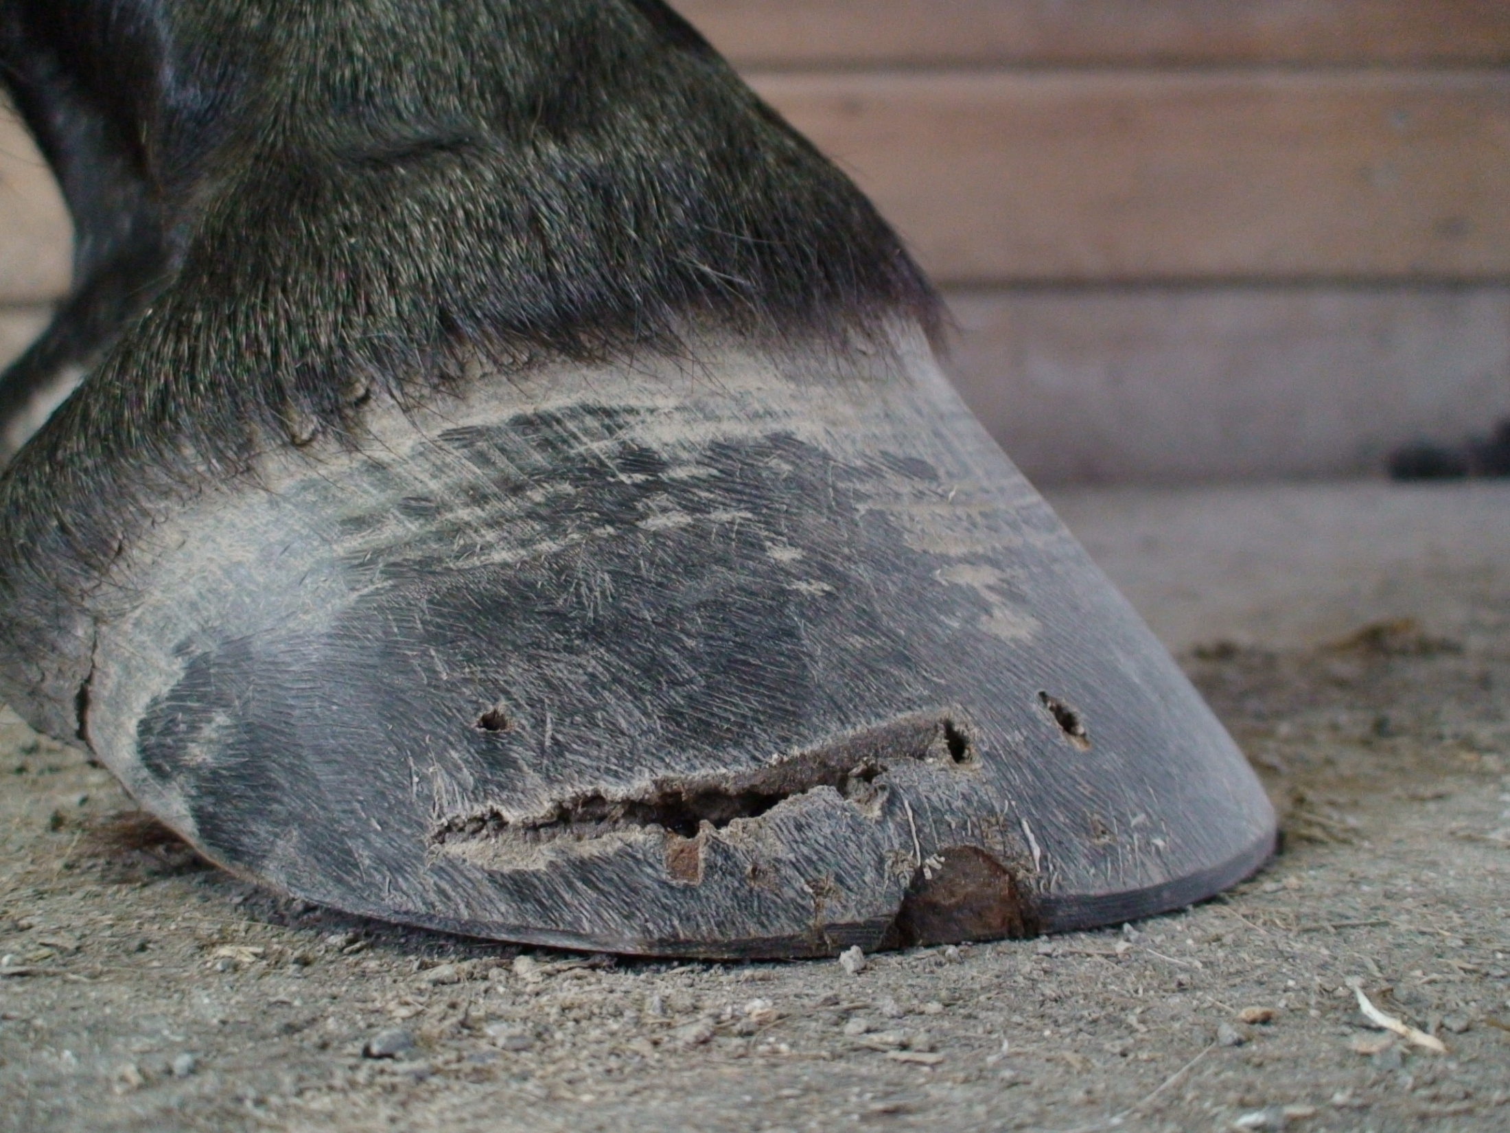
Lack of appropriate angle and length of heel cause the frog and bulbs to be more prone to bruising. This is a conformational fault that can not be changed by trimming.
Notice the heel of the hoof is not touching the ground when the horse is barefoot

Slide 37
Affect of the toe being too long.
When the toe is allowed to grow too long just like our fingernail the hoof wall will start to break up. Since it is constantly carrying a load this shows up as vertical cracks.
Cracks completely through the wall make the hoof is unstable.

Slide 38
Common Causes of Problems of the Hoof Wall
The number one reason for problems here is a hoof wall allowed to grow too long, check the schedule.
A wall that has a higher than normal moisture content will be weak, how often do you bathe your horse, is the paddock always wet?
A wall that is not strong enough to carry the load placed on it will bend and detach, is dobbin too fat?
A hoof wall that has been distorted due to faulty conformation or trimming will be unevenly loaded, if the mare had it good chance the colt has.
With a hoof wall too short a horse may be in some immediate discomfort, causing the sole to carry more weight than normal. This is usually a short term situation and can be easily remedied.
On the other hand a hoof wall left too long, especially on any horse with compromised conformation or being worked hard will be at increased risk of serious injury.

Slide 39
The Healthy White Line
Forms the connection of wall to sole.
Similar composition to the frog and periople.
A healthy white line allows the sole to drop under load.
The pliable nature of the white line protects the sensitive tissue that covers the lower border of the coffin bone.

Slide 40
Unhealthy White Line
An unhealthy white line will be of a variable thickness.
It may have black areas.
The outer border may be of a crumbly texture, seedy toe or white line disease.
It may have separations running at right angles to the wall, usually associated with a wall flare.
Or it may have separations running parallel to the outer border of the wall, overloading.

Slide 41
Advanced White Line Disease
A combination of fungus and bacteria invade the inner region of the wall destroying the attachment of coffin bone to hoof.
Usually this starts as a small area of separation on the ground surface.
Can be an indicator of unbalanced hooves or neglect.

Slide 42
The Healthy Sole
Concave, an arch gives strength to the hoof.
Thick, the sole covers the bottom of the coffin bone.
Elevated towards the heels.
Even thickness from toe to heel.
Free from bruising.
Have no punctures or splits.
Sole is modified skin and sheds old material as new is generated below. This can be seen on most horses as a crumbly material that is often loosened with the hoof pick. This is a normal process.

Slide 43
An Unhealthy Sole
Thin and flexible, not enough protection.
Flat, easily bruised.
Bruised, indicates damage to the underlying tissue.
Punctures or deep cuts, may cause infection (abscess) of the sensitive tissue underneath.

Slide 44
When a hoof has a flat sole quite often the side of hoof will have more slope than normal. This is not a strong hoof.

Slide 45
Flat thin Sole
A thin flat sole is usually associated with a weak hoof wall. The combination of weak wall and sole will make the horse more likely to suffer from bruising of the Sole, separation of the White Line and damage to the Hoof Wall

Slide 46
Bruising of the Sole.
Common sites of sole bruising are
in the toe region,
just in front of the tip of the frog
and in the corner of the heel.

Slide 47
The Healthy Frog
A healthy frog will be on the same plane as the heels.
Will be about one and one half times longer than wide.
The central cleft will have a slight depression.
A healthy frog will have a rubbery texture.
The frog will be wedge shaped on three planes.
Attached to the bars mid-way along each side.

Slide 48
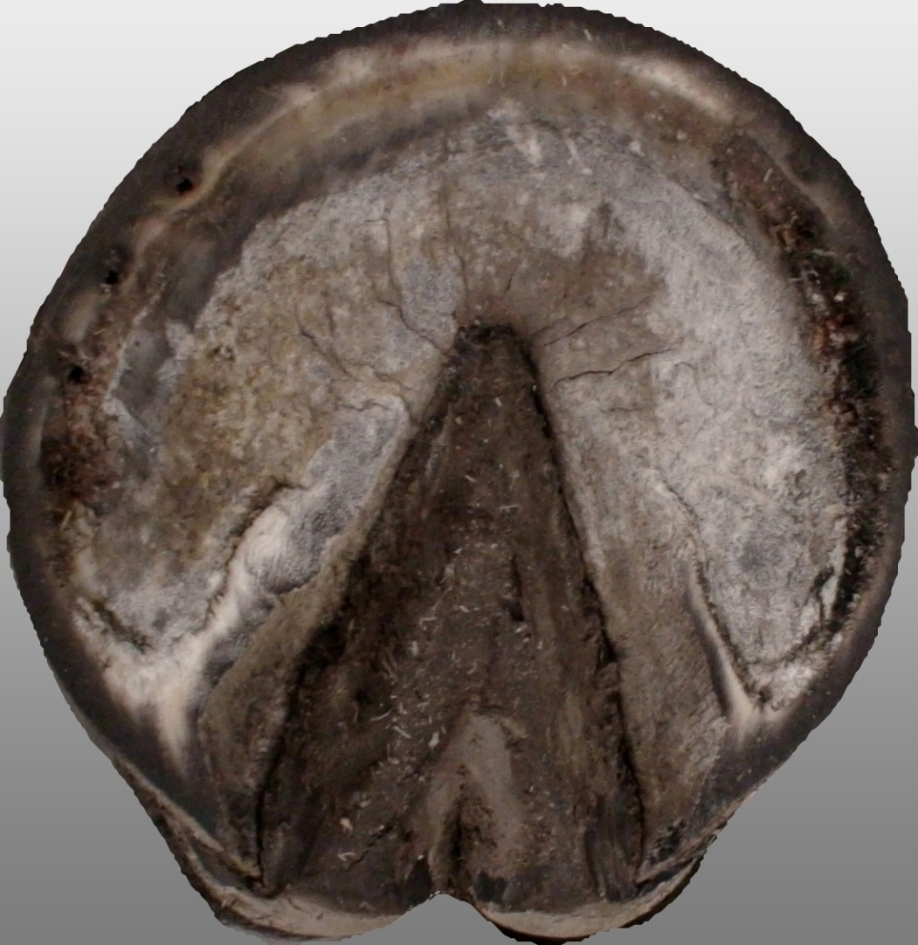
Healthy Frogs
Strong connection of frog to sole.

Slide 49
Different frogs of healthy hooves.
A deep foot with a tall frog.
A shallow foot with a wide frog.

Slide 50
The Unhealthy Frog
An unhealthy frog may have a deep central cleft. An indication of “Thrush”.
If the frog is long and narrow that can be associated with low heels, long toe.
A small frog may be an indicator of poor hoof function, heels too tall, or club foot.
An overly fat frog, protrudes beyond the plane of the heels may be a sign of a weak wall and sole.

Slide 51
An unhealthy frog.
A frog in this condition will cause the hoof to be unstable and may cause internal tearing of sensitive tissue.
Infection of the frog by “Thrush” will be a persistent problem.

Slide 52
Hoof Dressings and Hoof Quality
Few of the hoof dressing on the market have scientific studies to back up the claims made by the manufacturer. Some are harmful to the horse and can be dangerous to the horse owner. Many sold as moisturizers may cause the hoof to become waterlogged by disrupting the normal respiration process. Good quality hoof is the product of a well balanced diet rather than the application of a cosmetic at best of hazardous chemical at worst.

Slide 53
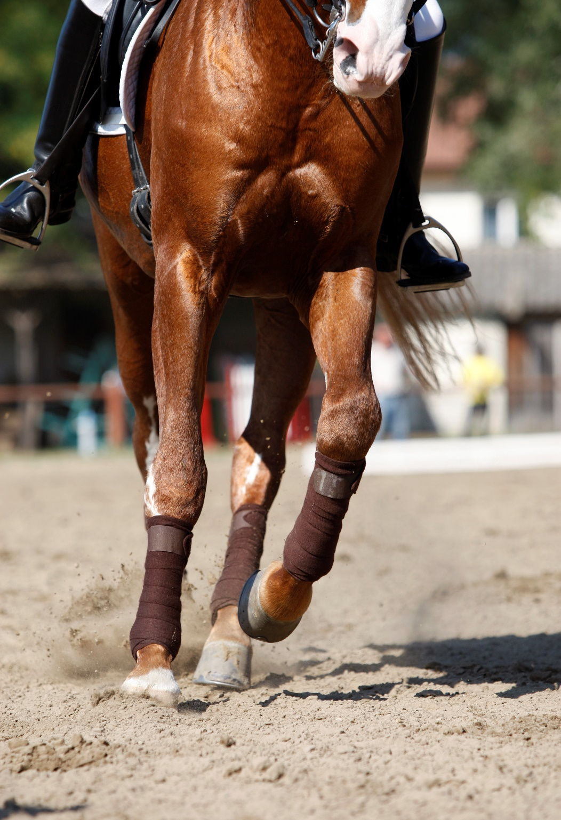
Chapter 3.
Good farriery.
Trimming goals.
How to tell if your horse is well shod.
What is needed to get the hooves trimmed properly.

Slide 54
The well shod hoof
Nail holes placed to suit the hoof with angle to allow nails to exit 1/3 of distance to hair line.
As few nails as possible.
Symmetrical shape to the shoe following and improving the outline of the hoof.
Clinches smooth and strong, with minimal damage to the wall. About twice as long a wide.
If clips are used, to be appropriate for the application, strong and blend into the hoof wall
Increasing in width behind the last nail. Extra length past the heel.

Slide 55
How the farrier looks at the hoof
To evaluate the conformation of the hoof and leg the farrier will watch the horse move. And examine each hoof on three planes.
From the front and back.
From the side.
From above and the ground surface.

Slide 56
Tools to measure the hoof
A hoof gauge will allow the farrier to keep a written record of the angles the hooves are trimmed to.
To accurately trim and shoe a horse the farrier should check the hoof with a short ruler. This will allow more precise work and can become part of the record or file for that horse.
Using the gauge to trim to a predetermined angle may not be the best way to use this tool.

Slide 57
Good trimming practice.
Each of the parts of the hoof need attention.
While the wall is the part that needs most work all the other parts need to be kept as healthy as possible.
The goal of the farrier is to keep the horse as comfortable as possible.

Slide 58
Trimming the frog.
The starting point for every trimming should be the frog. Only enough material should be removed to allow dirt to be easily expelled from the hoof under normal activity.
Over trimming the frog can compromise the health of the hoof and can lead to bruising of the frog.
The frog is an important shock absorber and aid to pump blood out of the foot and back up the leg. A healthy frog will also reduce the load on the hoof wall.

Slide 59
Trimming the Sole.
The sole will exfoliate just like our skin.
The sole should only be thinned enough to allow the wall to be trimmed to the optimum length.
The sole protects the sensitive foot within. Too thin a sole will lead to bruising.
The sole can also carry some of the horse weight.

Slide 60
Trimming the hoof wall.
The wall is the primary weight bearing structure of the hoof.
A healthy wall will be a short as possible and as thick as possible.
The outer border of the wall should follow the contour of the white line.
Regular trimming of the wall will show any problems before the get out of hand.

Slide 61
Good trimming practice.
Good trimming requires skill and constant practice.
A skilled farrier will develop a feel for the hoof. This combined with the observations of the whole horse will help to guide the farrier.
Since the horse can only stand on three legs for a short time the work must be completed quickly.

Slide 62
What is ‘good’ shoeing
Trimming the hoof to within 1mm and one degree of the ideal is required to maintain the strongest tissue possible.
The hoof wall must be the correct length and angle for the conformation of the leg.
The shoe needs to be fitted to the shape of the healthy white line, with the nail holes placed on the outer border of the white line.
The shoe should be fitted to allow for growth and normal functioning of the hoof for the duration of the shoeing cycle taking into consideration the management and work of the horse.
The shoe fit and trim should allow for a reasonable period between shoeing. Ideally when the horse is due for re-shoeing the hoof will still be on top of the shoe right back to the heel.

Slide 63
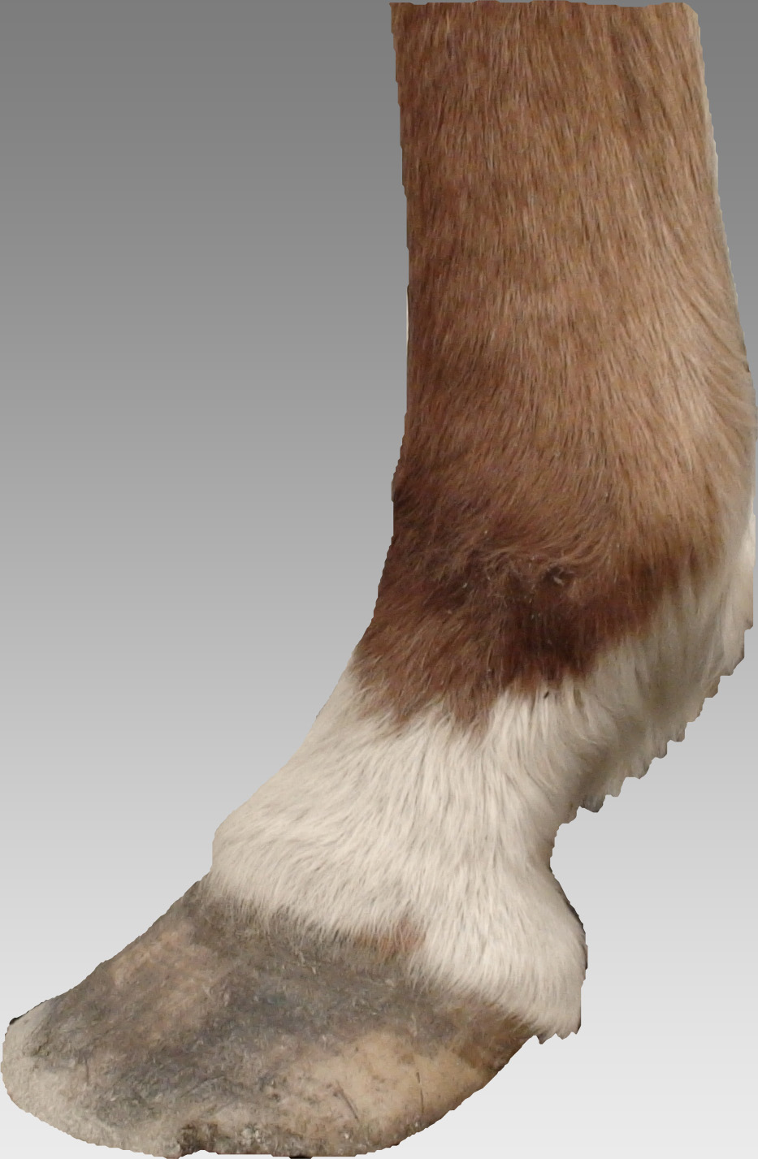
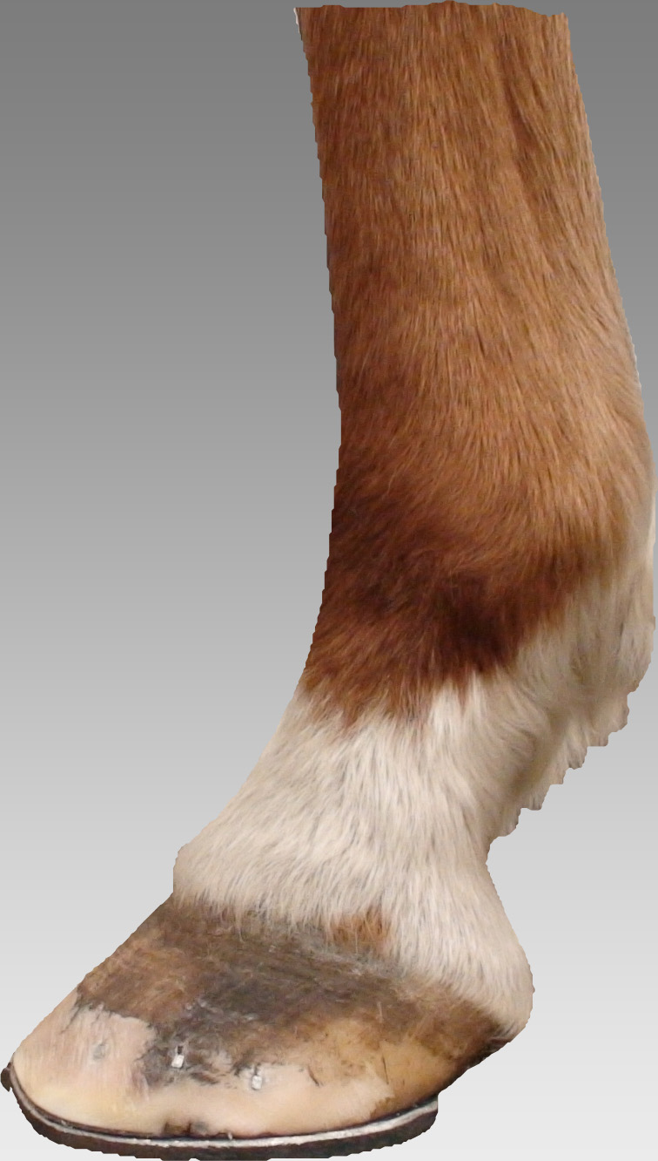
Long toe causes bend in the hoof wall.
End of the heel is further forward than ideal causing the heel to carry too much of the horses weight.
This in turn may cause damage to tendons and ligaments of the leg if the horse is in work.
The shortest possible toe length with the thickest sole will reduce the load on both hoof wall and tendons and ligaments.
If the wall is weak a shoe fitted to the white line of the hoof will add strength to the hoof.
A shoe that is wider than the hoof after the last nail and longer than the hoof by 1/8 – 3/8 will allow for proper functioning of the hoof.

Slide 64
The well shod hoof
Ideally when the horse is due for re-shoeing the hoof will still be on top of the shoe right back to the heel.
The shoe fit and trim should allow for a reasonable period between shoeing.

Slide 65
Not correcting just maintaining.
Common conformation defect.
Outward rotation of both fore legs.
As the hooves get longer the defect is exaggerated.
The effect of shortening the hoof and providing support to the back of the hoof and leg makes the horse appear more correct.

Slide 66
Before shoeing
angle of pastern
and angle of the
hoof are
different.
After shoeing hoof trimmed to suit individual conformation and shoe fitted to support the hoof and leg
Excess toe length causes strain on the hoof and leg.

Slide 67
In this case either too much time has gone by between shoeing or the shoe was a poor fit for the hoof. Quite often both of these factors are combined with less than ideal conditions for the horse to live in. If the horse is then expected to compete at a high level unsoundness can be a result.
If the shoe is inside the hoof at the heel either the shoe was not fitted correctly or the shoeing cycle was too long.
When the front face of the hoof has a bend in it that is a good indicator that the toe is too long.

Slide 68
Owner neglect or poor farriery?
The hoof has grown so long the shoe no longer supports the heel.
The same hoof trimmed correctly with a shoe to allow for six weeks growth.
Long enough to allow for growth of hoof
Shoe that is wide enough to allow for hoof expansion
Nails placed about 1/3 way up the hoof wall with strong smooth clinches

Slide 69
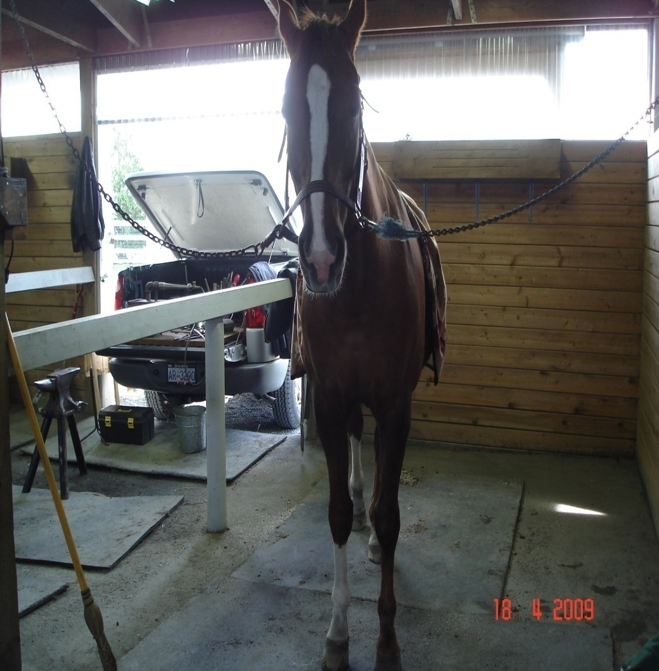
What you can do to help your farrier do the best job possible.
Provide a safe quiet area to work that they can get their truck close to.
A flat non slip surface for the horse to stand on in an area that the horse is comfortable.
Secure tie spot or someone competent to hold the horse.
Shelter from the elements, both sun and rain.
Excellent lighting with white or light coloured walls.
The area needs to be large enough to safely move around the horse without getting in trouble.
Let your farrier know about the activities at the barn especially any unusual events so they can plan around them.

Slide 70
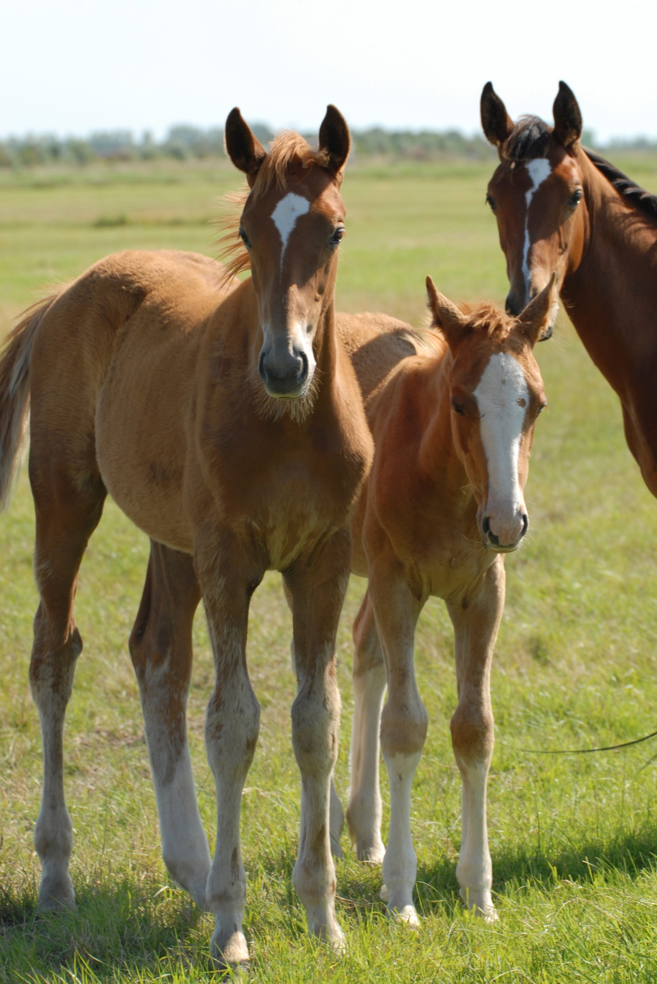
Chapter 4.
The role of breeding.
Conformation faults.
How a skilled farrier can help.
How “corrective shoeing” is an incorrect term.

Slide 71
Common Conformation Faults
Thin walls.
Flat soles.
Broken back hoof pastern axis.
Broken forward hoof pastern axis.
Hooves that are not under the center of the leg.
Legs that are turned in or out from the center line of the horse.
Mismatched hooves.

Slide 72
Breeding or poor farriery
While poor management
or farriery can make things worse breeding less than ideal conformation
is the underlying cause of most leg and hoof problems
This hoof shape was caused by attempting to correct less than ideal conformation
Remember the hoof is a plastic form on the end of a more rigid form, the leg.

Slide 73
The same hooves from the bottom.

Slide 74
After trimming. This horse now toes in more.

Slide 75
Supporting the hoof and leg.
This individual carries more weight on the inside heel of both fore hooves.
When this is combined with poor trimming and shoe fitting the soundness of the horse will be challenged.
This horse should be shod to land as level as possible. And the shoe should be fitted with a little more shoe exposed on the inside. In some cases this will make the conformation fault appear more pronounced. This may also make it more likely that the horse will step on the shoe with the opposite hoof. Neither should be the first consideration of the farrier.

Slide 76
Supporting the leg and hoof.
Support

Slide 77
Mismatched feet
While this has made the horse more comfortable the underlying conformation defect still remains unchanged.
Heel of the shoe.
Heel of the shoe.

Slide 78
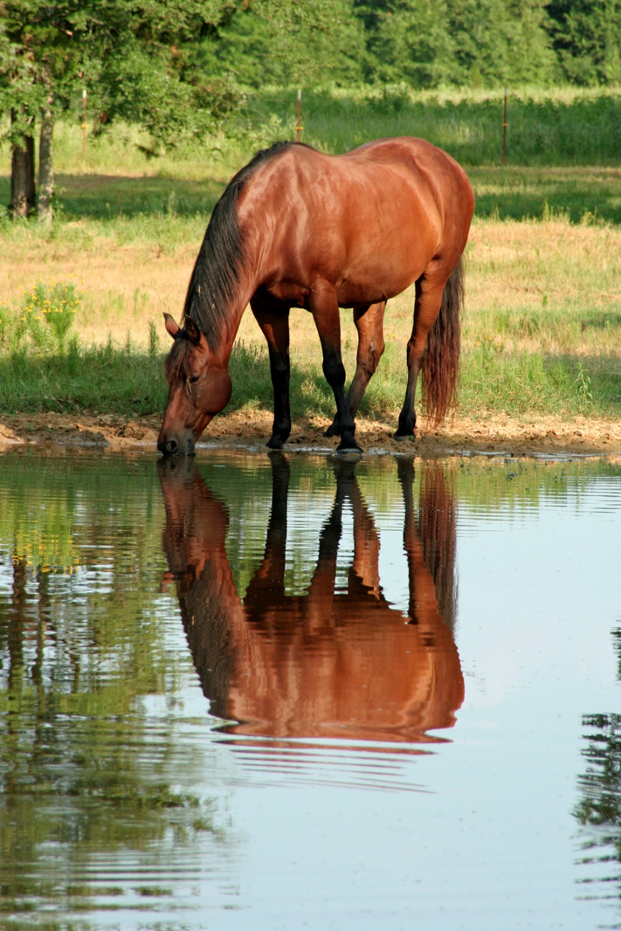
Chapter 5.
Do all horses need shoes.
Alternatives to steel shoes.
The role of pads.

Slide 79
Do all horse need shoes.
Horses should be shod for the following reasons.
Protection: A variety of diseases or a hoof wall that will wear too short are a common reason to shoe.
Traction: More or less grip may be necessary depending on the discipline the horse is used in.
Support: Due to conformation or disease a therapeutic shoe may be needed to improve or maintain the soundness level of the horse.
Most farriers will have about 15% - 30% of their clients horses barefoot.

Slide 80
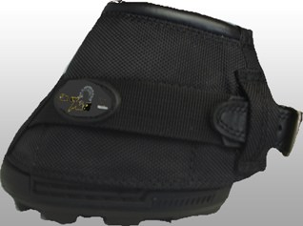
Hoof Boots
Keeping your horse barefoot would be the best solution, unfortunately not many horses can stay sound and work barefoot.
A good fit is important and the hooves will need to be trimmed on a regular schedule.
Using boots has become a more common practice. For horses who only need some protection for light riding this can be an option.

Slide 81
Alternatives to steel shoes
There are a variety of alternatives to steel shoes today. Plastic shoes can be nailed or glued to the hoof. Some can be molded in hot water while other are trimmed to fit. A shoe can be made from a two part urethane glue or an aluminum shoe can be glued to the hoof.
The higher cost and lack of familiarity with the application process discourages most farriers and owners from using a glue on shoe.

Slide 82
The Barefoot Horse
In the past twenty years there have been a range of ideas on how a hoof should be trimmed. Some are based on studies of feral horses while others try to impose a rigid formula no matter what the conformation.
If you think your horse could go barefoot choose a time of year when the hooves will be at their driest and your horse will not be working too hard.
The goal should be a sound horse working comfortably.
If your current farrier is hesitant to explore this option don’t just assume it’s because he/she fears a loss of income. Every farrier has a percentage of client horses barefoot. It may be that your situation will not allow your horse to meet your demands while barefoot.

Slide 83
Pads
Pads can be a useful addition to the hoof. Depending on the situation a pad may offer protection, reduce concussion, or change the loading of different parts of the hoof.
Adding a pad may make the sole of the hoof softer and thinner and may make it more difficult to keep a shoe in place.

Slide 84
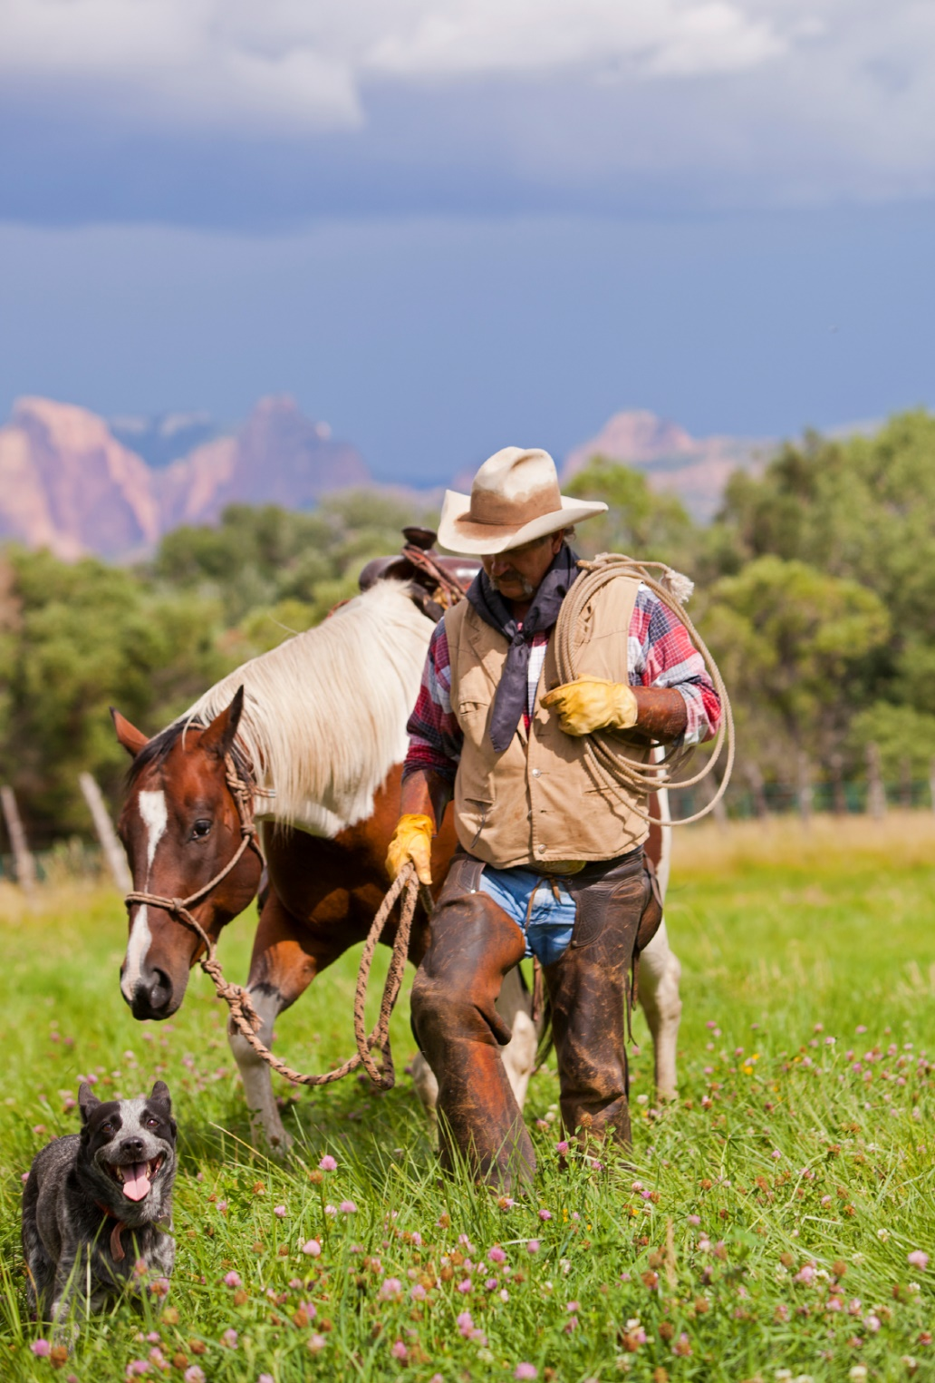
Chapter 6 Common Problems
Loose shoes
Forging
Brushing
Abscess

Slide 85
Removing a loose shoe.
If your horse has twisted or stepped on a shoe and loosened it. First see if it can be easily taken off. If not then confine the horse until the shoe can be fixed.
To remove a shoe you will need a pair of Pincers or Shoe Pullers. If possible remove each nail individually. To avoid hurting the horse pull from heel to toe, not over the outside edge of the hoof or onto the sole.

Slide 86
If your horse has lost a shoe.
Keep the shoe if you have it.
If not see if you can find it.
The shoe will help the farrier to decide what needs to be changed to prevent a recurrence.
Horses can often lose a shoe shortly after shoeing, this is because the hoof is at its smallest in relation to the shoe. This then exposes more shoe for the horse to step on.
About eighty percent of the shoes lost in a farriers practice are lost by twenty percent of the horses.
This can be due to, conformation, management or environmental causes.

Slide 87
Forging.
Forging is the striking of the toe of the hind shoe on the inside of the toe of the fore.
This problem can be linked to conformation and trimming. Another cause can be rider skill.
A slight change in the period between shoeing, or the trim, fit and type of shoe may make a positive change.

Slide 88
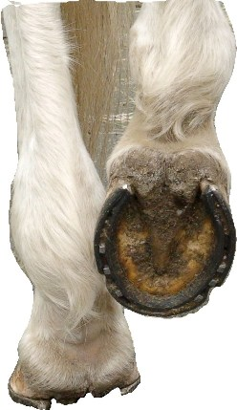
Brushing
Often a young horse when first put to work will brush or forge. This may only be a temporary situation that will disappear as the animal becomes fitter. Unless the problem is severe it is better practice to protect the horses legs and see if improved fitness will solve the problem before any remedial shoeing is attempted.

Slide 89
Abscess
One of the most common causes of lameness.
Infection of the sensitive foot within the hoof.
Call your veterinarian.
Sudden onset lameness.
Check for current anti-tetanus status.
Heat, swelling, non weight bearing.
Your farrier is qualified to open an abscess but should not invade sensitive tissue.
To the inexperienced may look like shoulder lameness.

Slide 90
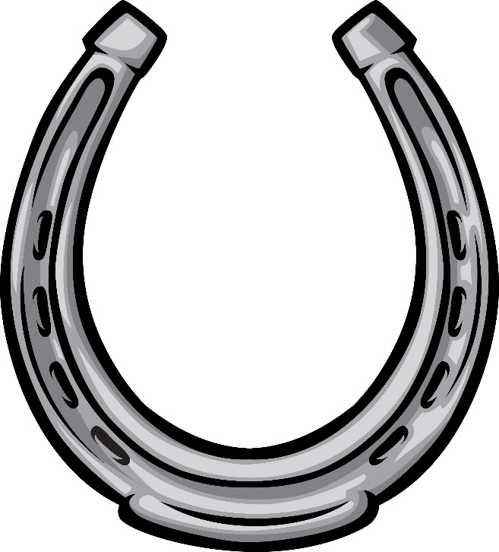
Chapter 7.
Farrier Training.
Farrier education.
Farrier organizations.
Continuing education.
Farrier examinations.

Slide 91
Farrier Training.
Kwantlen University offers a nine month program.
This should be followed by a one or two year apprenticeship with a skilled full time farrier.
Olds College offers a seven month training program.

Slide 92
Farrier Education
Beginning with a period of study at a recognized institution.
Followed by 1 – 2 years as an apprentice with a knowledgeable practicing farrier.
During which time the apprentice should be taking the series of exams offered by the American Farriers Association.

Slide 93
Farrier Industry
Western Canadian Farriers Association
Group of farriers in Western Canada whose goal is to provide education opportunities for farriers and horse-owners. Holds voluntary exams for farriers twice a year.
Affiliated with the American Farriers Assoc.
www.wcfa.ca
American Farriers Association
An international body that organizes educational events. Also offers a series of exams to establish recognized levels of farriery skill. Provides the examiner for exams organized by regional associations.
www.americanfarriers.org
Worshipful Company of Farriers
A British guild responsible for the examination of farriers in the U.K.
http://www.wcf.org.uk

Slide 94
Continuing Education for farriers
Your farrier should be a member of one of the associations.
The W.C.F.A. offers several opportunities each year for farriers to get together and improve their skills.
Workshops and clinics are also held at Kwantlen University in Cloverdale B.C. and Olds Community College, Olds AB.

Slide 95
The various levels of farrier exams with the A.F.A.
A.F.A. Farrier Classification. This exam is designed for beginning farriers, those who have just completed either an apprenticeship or some type of formal course in farriery.
A.F.A. Certified Farrier. This certification consisting of theory and practical is directed at those who have the ability to apply a pair of manufactured shoes with or without hot shoeing. The candidate must also present a selection of forged shoes and complete a theory module. Most farriers have this level of certification.
A.F.A. Tradesman Farrier. This level tests the ability of the candidate to modify manufactured shoes and hot shoe a horse. It also has a theory module.
A.F.A. Journeyman Farrier. This level tests the farriers skill to forge a set of shoes and hot fit. Also has a theory module and a practical module where the candidate has to forge a bar-shoe to fit a template.
A.F.A. Therapeutic Endorsement. This exam is designed for those farriers who are working on complicated lameness cases.
A pre-requisite to each exam is success at the previous level.

Slide 96
Conclusion.
Answers to the original questions.
Additional information.

Slide 97
Answers to the original questions
Your horse has abscesses on a regular basis.
If your horse suffers from persistent abscess most likely the hooves are too wet and weak.
One or more of the hooves has white line disease.
White line disease is usually caused by a combination of factors, conformation, wet ground, poor management or careless trimming.
Are the heels too low.
Low heels can be manufactured by the farrier but that is an artificial conformation imposed on the hoof. If you believe your farrier has created the situation then have him/her leave the heel alone and it will re-grow if that was the case. On the other hand if it is caused by conformation no amount of trimming or application of material will change that. You can change the angle of the hoof with pads, urethane or wedge shoes. Once these are removed the hoof will return to its “normal” conformation.
The hooves don’t look as good as they used to.
If the hooves don’t look as good as they used to do you have a photo record of how they did look previously? It’s a good idea to periodically take photo’s of your horses hooves and keep them for future reference. Sometimes we forget just how bad they used to look. If you think they are deteriorating then something has changed to cause that. It could be a long spell of very wet weather. Perhaps a change of footing or work the horse is doing. Did you change your farrier or do you feel it ‘s time to have a conversation with them and consider your options. Of course your farrier should be commenting on changes she/he sees in the hooves. A farrier who is paying attention will be the first to notice the hoof not looking as it should and they should be bringing it to the owners attention. Don’t just change farriers with out first talking to your current one about the issue. Because you may not have all the information you need to make an informed decision.

Slide 98
More Answers
Your farrier won’t do what you want.
If your farrier won’t do what you want. You need to ask some hard questions, such as, why? Quite often farriers are asked to do things to a horses hoof that are not appropriate for that individual and may lead to further problems. A good example is trying to make a horse with crooked legs look straighter or matching up mismatched hooves. Every few years a new “fad” comes along on how to either trim or shoe a horse, most farriers are wary of demands from owners that come from magazine or internet sources. You should be too. Don’t be a fad follower . Hopefully you are employing a professional to take care of your horse so question them for information about what is best for your situation. If you still feel that you are not getting good service suggest your farrier have another farrier come and do a consult on the problem. Lots of other professionals do it and it should happen more often in situations like this.
Is your horse sore after trimming.
If your horse is sore after trimming, something needs to change. Surprisingly some owners think this is a normal part of the process and never inform their farrier. It’s not normal and your farrier should be aware of it. It could be that the horse should have boots, shoes or shoes and pads, depending on your situation if being barefoot is not working. If the horse lives in wet conditions and works on a hard dry surface then that needs to be addressed. It would be better for the hoof if the horse lived on the dry hard and worked in the wet. Perhaps the hooves need more frequent trimming taking less off at each trim. Often barefoot horses are left so long that the farrier is forced to trim aggressively just to take care of problems.

Slide 99
Answers
Is the cleft of the frog deep and fleshy?
If the cleft of the frog is deep and smelly your horse has a hoof that is in trouble. If the hoof had a crack at the toe all the way through the wall you would be concerned, right? Well this is much the same, now the back of the hoof is in two pieces. The hoof is unstable and needs support. Sometimes a change to dry conditions and some over the counter medication will do the job. If that’s not the case then it’s time for the vet. and farrier to get together.
Are there cracks in the wall of one or more hooves?
If you have numerous cracks in the hooves this is a good indicator of the overall health of the hoof. If they are shallow on the surface something may be missing from the horses diet, look at adding a supplement such as Farriers Formulae or is it a case of neglect. Remember the hoof you see is up to eighteen months old. If the cracks start from the bottom and are working up the hoof this is usually a case of neglect on someone’s part. While not an emergency these types of cracks must be taken care of or they will migrate to the hair line and cause real problems, If they start at the coronary band then this may be a conformation problem or a trimming issue, combine either of those with hard work and the hoof will come apart. This will be a serious issue for the horse and needs to be addressed right away.
Does your horse have mismatched hooves?
If your horse has mismatched hooves most likely so did one or both of the parents. Sometimes an upright hoof will develop from an underlying lameness. Either case you have to learn to live with it. Next time buy a horse with matched hooves.

Slide 100
Answers
Is your horse sore after shoeing?
If your horse is sore after shoeing make sure your farrier knows about it, there is a reason and it’s not always what you might think. Sometimes horses have difficulty having a leg bent to allow for trimming and shoeing. Other times it may be a disease of the hoof that causes pain such as a deep seated bruise of the coffin bone.
Has your horse ever lost the whole frog?
If your horse has just lost all of the frog don’t panic it’s a normal process that has been affected by local ground conditions. A dry period will cause the frog not to shed much material, if this is followed by wet then the frog may come away as one piece. The new frog is right there and just needs some time to toughen up.
Does your farrier complain that the hooves are too soft?
If your farrier complains that the hooves are too soft pay attention. Ask him/her to help you come up with a solution that will work for your situation.
Do you know when your horse is due to have it’s hooves trimmed?
While a business minded farrier will keep track of when your horse may be due for a visit don’t leave it until the last minute to call. Remember your farrier should be part of the pit crew helping you meet your equine goals.
Does your horse avoid hard ground when ridden?
If your horse is constantly avoiding hard ground let your farrier know. Most likely they are already aware of the problem, a thin sole. Again the solution will have to be tailored to the situation, perhaps a wide shoe or pad or not touching the bottom of the hoof with a knife during trimming.

Slide 101
The final answer
Would you like to pay less for shoeing?
Of course we’d all like to pay less for things, the best way to save money on farrier bills is breed or buy a horse with excellent hooves. Too many times a horse purchase is made with little regard to the hooves. Next time you are in the market for a horse take your farrier along to be part of the pre-purchase exam team. Also you should have regular communication with your farrier , if you do that will help to ensure you are getting value for your hard earned money. Your farrier can be a great resource of useful information on horse related matters, not just the hooves. Most farriers are excellent horse men or women. Having said that farriers charge for their time ,even though on the bill it will say “shoes or trim”, if you are going to use up a lot of time expect to pay for it.

Slide 102
More information
When looking for more information on this subject make sure it’s relevant to your local area and climate.
For example the hoof care challenges an owner from a dry part of the country has will be different to those living in a wetter area.

Slide 103
Are your horses hooves healthy?
If the horse is barefoot does it avoid some types of surface?
This may be an indication of thin soles or bruising.
Are the hooves matched pairs?
If not you need to discuss this with your farrier. Many horses today have mismatched pairs of hooves, this can be due to breeding but can also be caused by incorrect trimming.
How to check if the hooves are mismatched.
If you have a hoof protractor use that, though it’s not that accurate with a shoe on the hoof. Another simple way is to look at the heels of the fore hooves from between the hind legs. If there is a difference of heel height then the horse most likely has mismatched hooves.
If the horse is shod can you see the end of the shoe beyond the hoof?
If not the shoe is too short or has been left on too long.

Slide 104
More hoof checks
Does the wall at the toe make a straight angled surface from coronary band to ground?
If not this is either due to too long a trimming cycle, the toe region being left too long during trimming, or a very thin hoof wall.
Is the White Line the same width from heel to heel?
If not that’s an indicator of, a weak hoof wall, wall overloaded, less than ideal conformation, or incorrect trimming.
Is the sole strong and concave?
If the sole flexes under thumb pressure that indicates a thin sole, may be due to breeding, environmental conditions, or excessive trimming.
Is the frog the same height at the heels as the wall?
If not that may indicate a frog that has just shed off or it may be connected to poor hoof function. If it’s higher that may point to collapsed heels. Is the cleft of the frog a slight indent? If the cleft is deep that may make the frog more susceptible to “Thrush”.

Slide 105
More hoof checks
Is the shoeing cycle tailored to suit the horse or vice versa?
Each horse should have a trimming and shoeing cycle tailored to suit. A yearling will have a hoof growth rate twice that of a horse in its teens.
How often do you bathe your horse remember his hooves don’t like too much moisture?
The wetter the hoof the more problems you can expect to have. In most of B.C. it would be difficult to make a hoof too dry.
Does the wall at the toe make a straight angled surface from coronary band to ground?
If not this is either due to too long a trimming cycle, the toe region being left too long during trimming, or a very thin hoof wall.
At the end of the shoeing cycle are the shoes tight on the hooves?
If your horse is frequently loosing shoes that should be addressed. There are many factors that can cause a horse to constantly loose shoes. Kicking the wall or ground, getting caught under the wall of the trailer, a fore shoe being stepped on by a hind shoe, twisting them off by constantly turning at speed, bailer twine frozen in the ground. These are just a few of the causes of shoes getting pulled off, they never “fall off”.

Slide 106
The coffin bone is suspended from the inner face of the hoof wall.
In a healthy hoof the coffin bone should sit at a slight angle to the ground. Suspended from the inner face of the hoof wall.

Slide 108
About the author.
Gerard Laverty got his start shoeing horses for his parents riding school in Ireland. Following a thirty year career in Ireland, the U.S. and Canada he began teaching the farrier program at Kwantlen University.
During his time at Kwantlen he has earned the top credential from the American Farriers Association and an Associate Fellowship from the Worshipful Company of Farriers, London U.K.

Slide 109
An Unhealthy Wall
Cracks and splits, may be due to unbalanced hoof, trauma, or infection.
Flares or dishes, hoof too long, weak, or overloaded.
Separations, overloading, wall too long, poor shoe fitting.
Displacement, uneven loading of one area of the hoof.
Scar tissue from old injury.

Slide 110
Refrences
Dr. Marvin Beeman: Lecture on conformation and form to function of the horse
Dr. D. Butler: Principals of Horseshoeing 3rd. Edition.
Turner T.A. 1992. The use of hoof measurements for the objective assessment of hoof balance. To measure your own horse, measure the circumference of the hoof just below the coronary band around the hoof then use a weight tape to calculate the weight of the horse.

